Slide 1

KARMA GIGS
Irina Grinico, Phillipp Schürch, Carlota Soler Arasanz

Slide 2
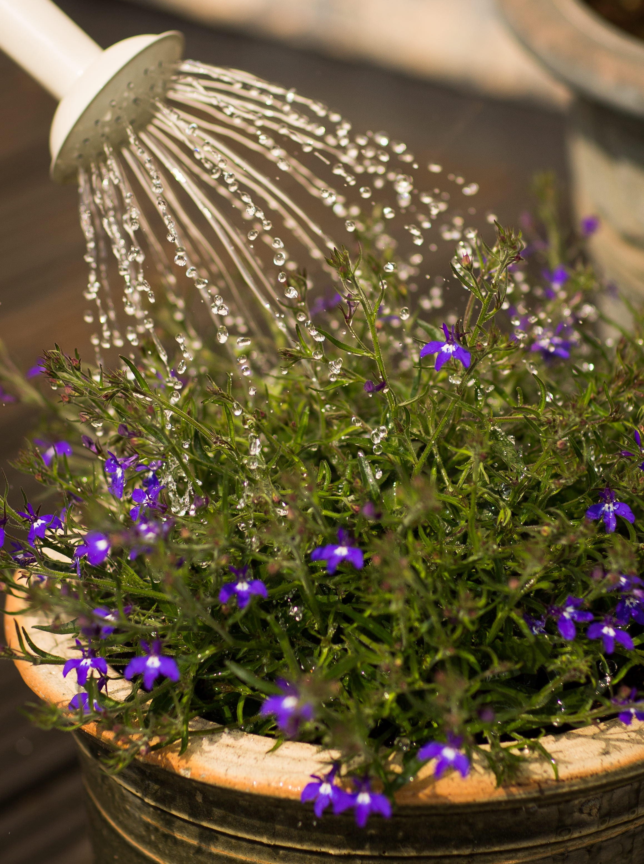


Problem
KARMA GIGS

Slide 3










Idea
KARMA GIGS

Slide 4
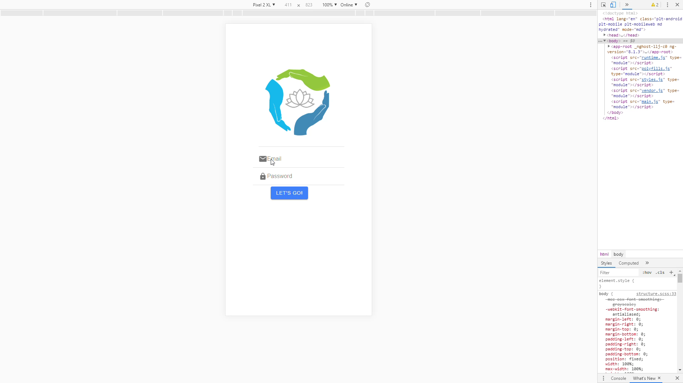
How
KARMA GIGS

Slide 5

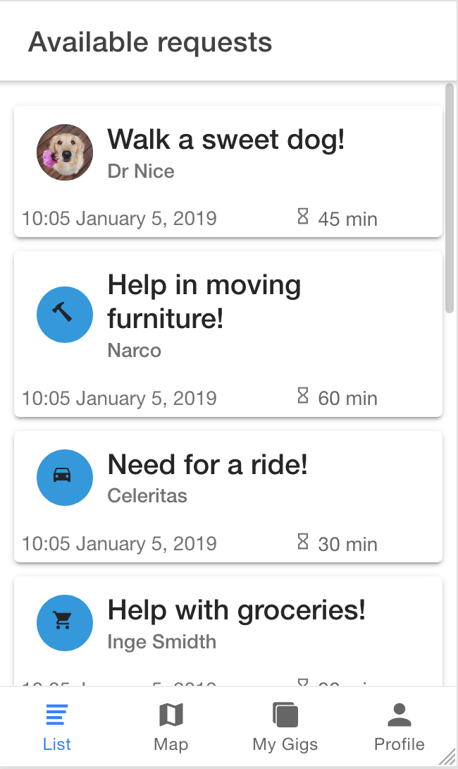
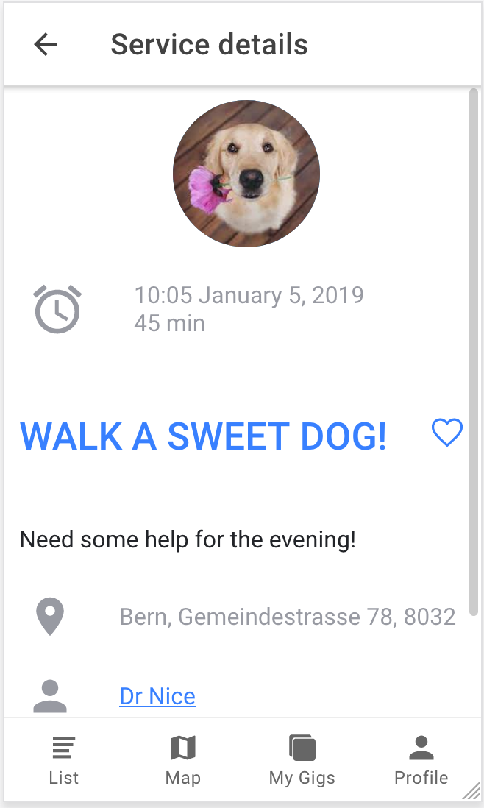
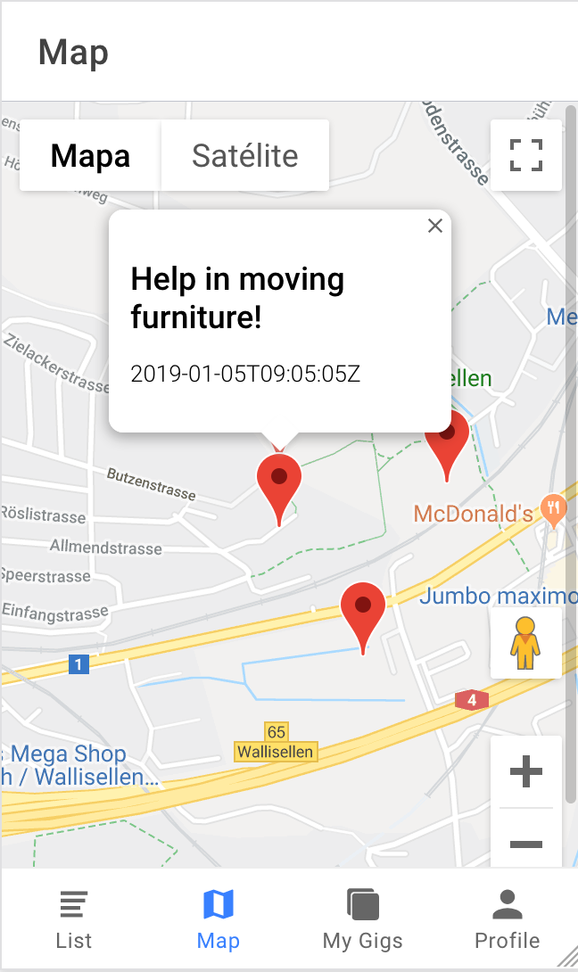
How
KARMA GIGS

Slide 6
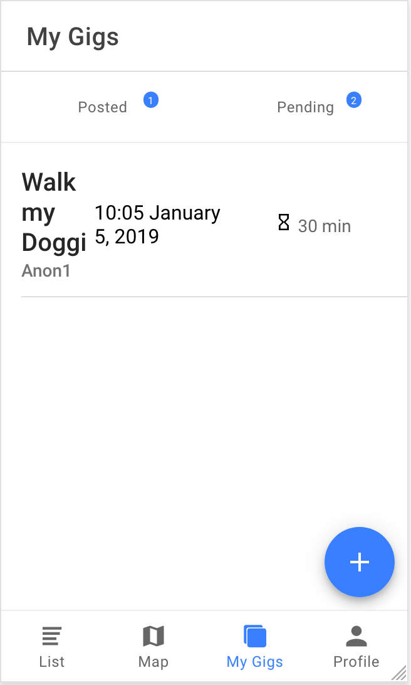
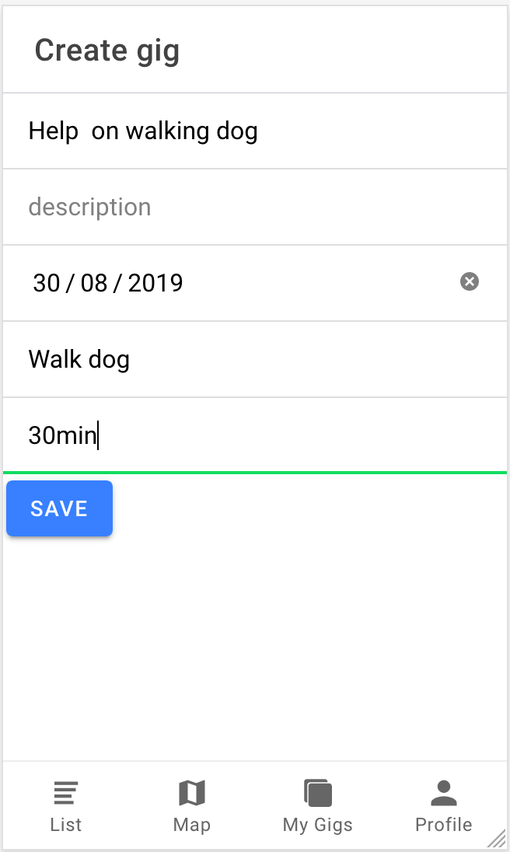
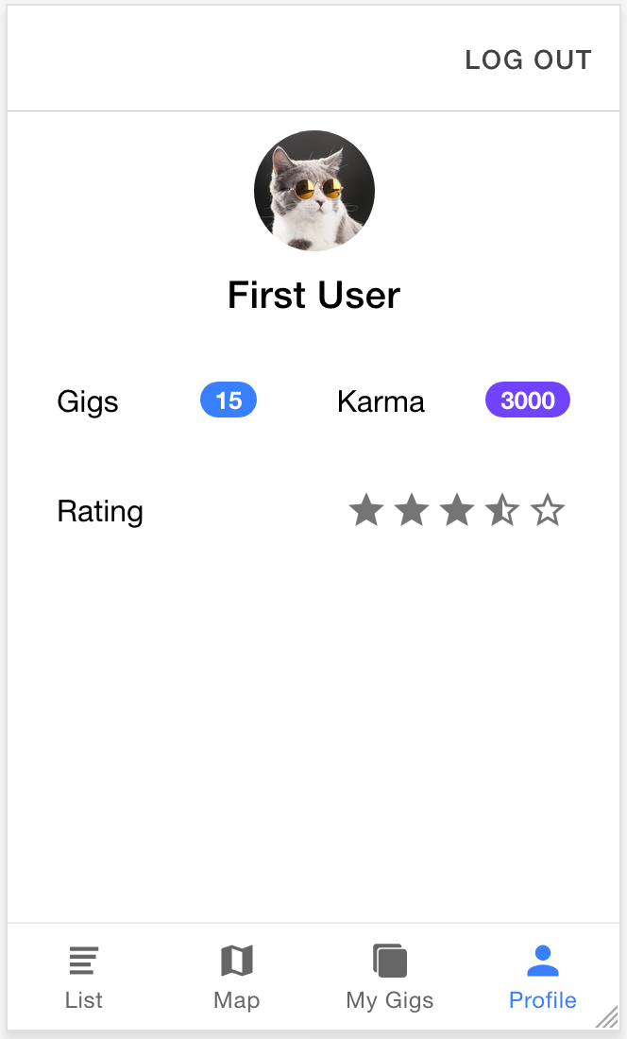
How
KARMA GIGS

Slide 7
KARMA GIGS
Irina Grinico, Phillipp Schürch, Carlota Soler Arasanz

